Slide 1

CIS 440 Capstone Project
Circle K Stores, Inc.
Presented by The Notifier
Point Of Contact: Kevin Reed
Title: Unix Systems Senior Analyst - IT Systems

Slide 2
Project Needs and Scope
A mobile application which can interface to existing database for the purposes of doing specific functions within those applications. These applications would be used in a phone or tablet, away from the business to perform these functions.

Slide 3
Primary Features
Change Control
Ability to view a ticket
Ability to approve or disapprove a ticket
Access to information from mobile environment away from the business
Incident Reporting
Ability to create and edit incident reports
Access to information from a mobile environment away from the business

Slide 4
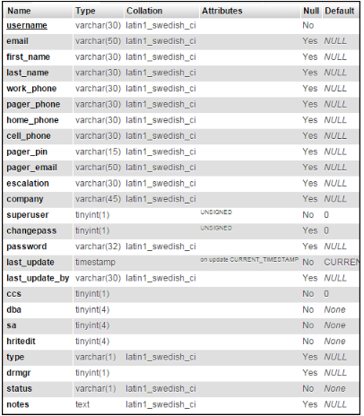
Database Design for Login Information
Notes:
2 database
We may need to build it ourselves with sample data to test the application

Slide 5
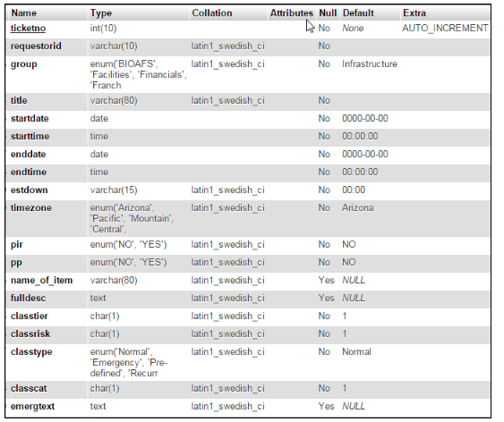
Ticket Database

Slide 6
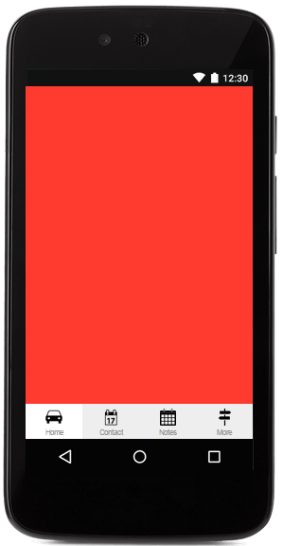
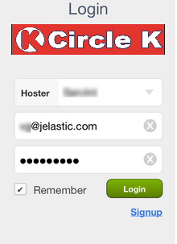
Notes:
Sample login page on the mobile

Slide 7
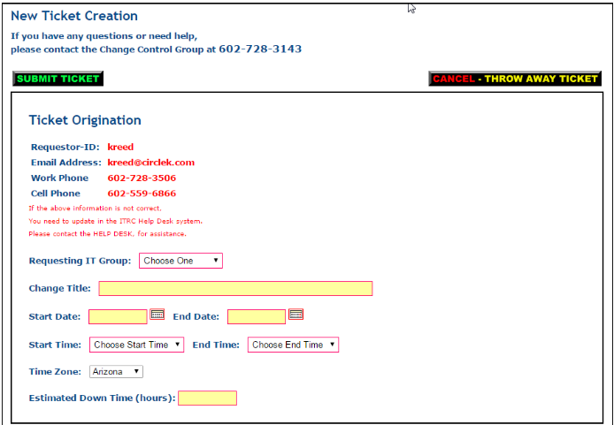
Notes:
The new ticket creation form will be convert to a mobile format

Slide 8
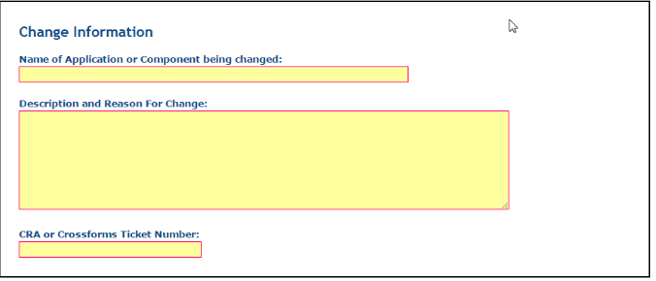
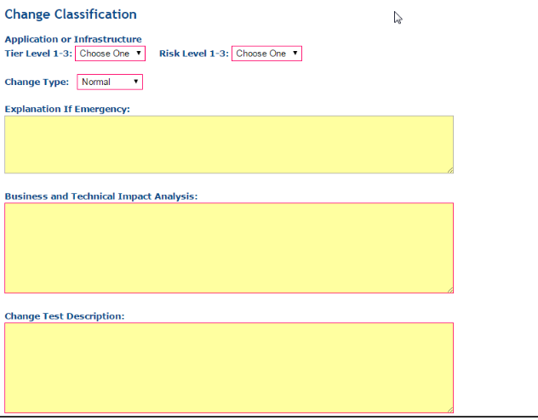

Slide 9
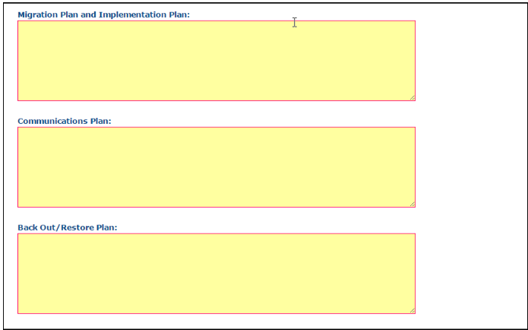
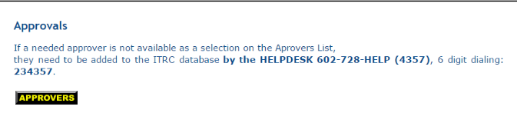

Slide 10
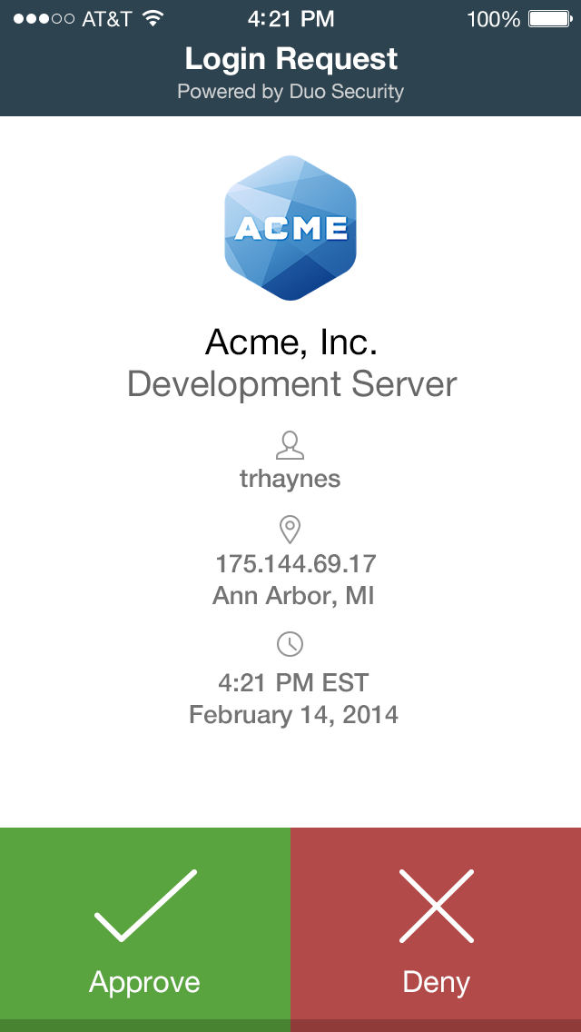
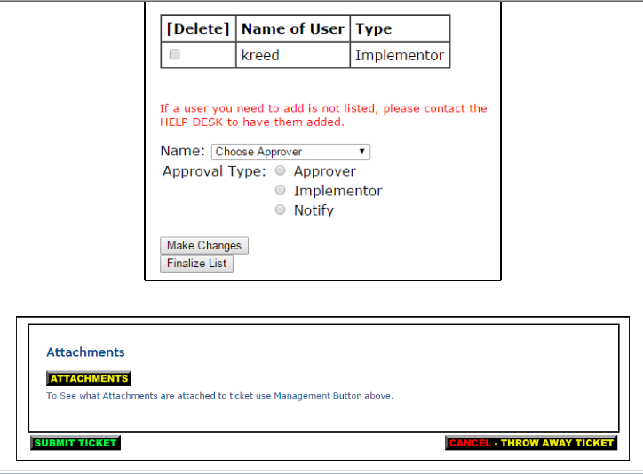

Notes:
Sample of approve or decline page

Slide 11
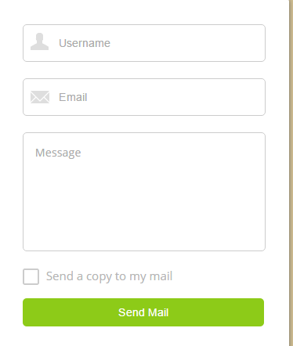
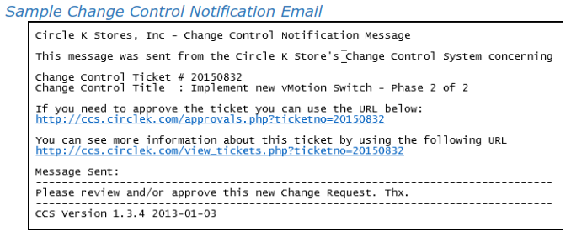
Email

Slide 12
